Slide 1


Azərbaycan Dövlət Neft və Sənaye Universiteti
Calculus
Single Variable

Slide 2
Improper Integrals

Slide 3
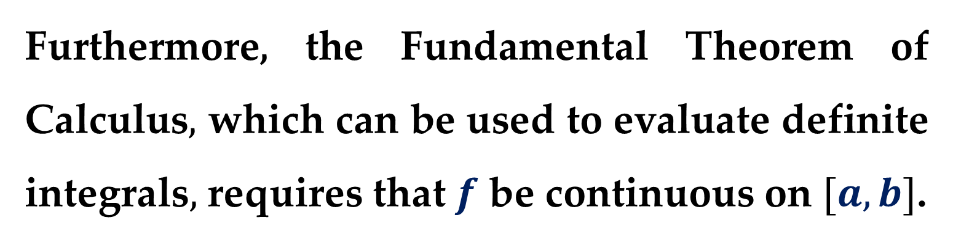
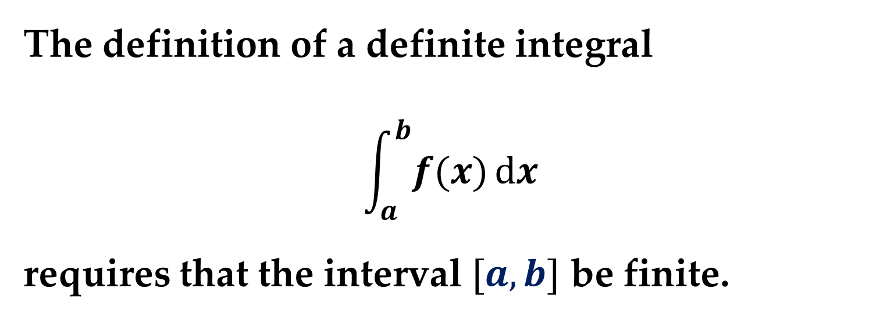
The definition of a definite integral
$$\int_{a}^{b}{f(x)}dx$$
requires that the interval $[a,b]$ be finite.
Furthermore, the Fundamental Theorem of Calculus$,$ which can be used to evaluate definite integrals$,$ requires that $f$ be continuous on $[a,b]$.

Slide 4
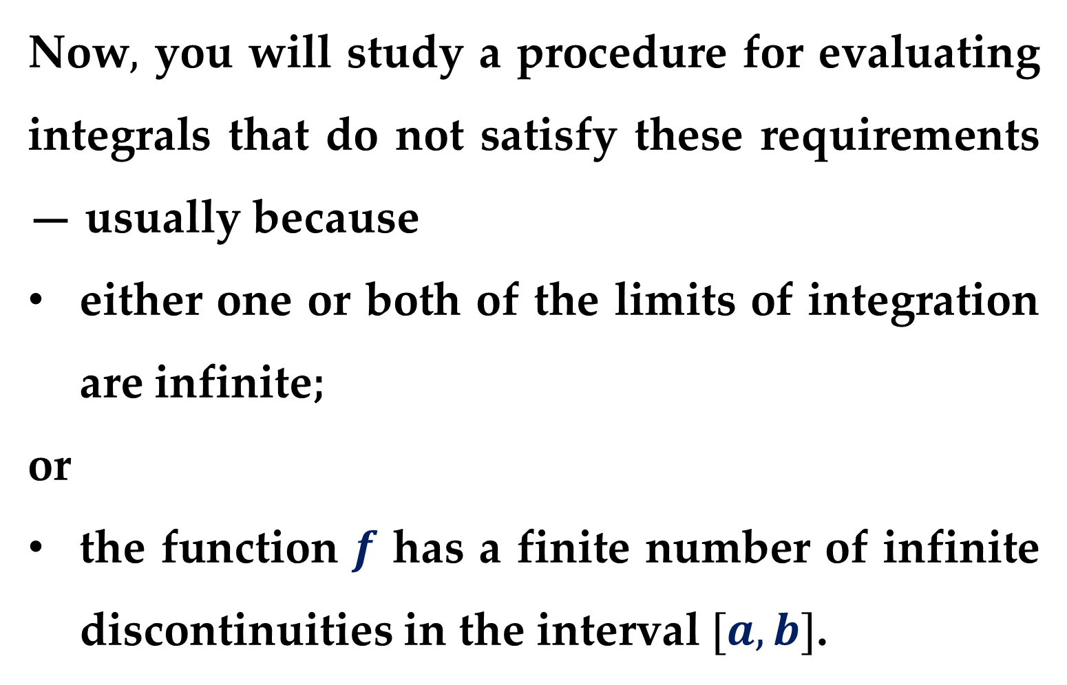
Now$,$ you will study a procedure for evaluating integrals that do not satisfy these requirements — usually because
either one or both of the limits of integration are infinite;
or
the function $f$ has a finite number of infinite discontinuities in the interval $[a,b]$.

Slide 5
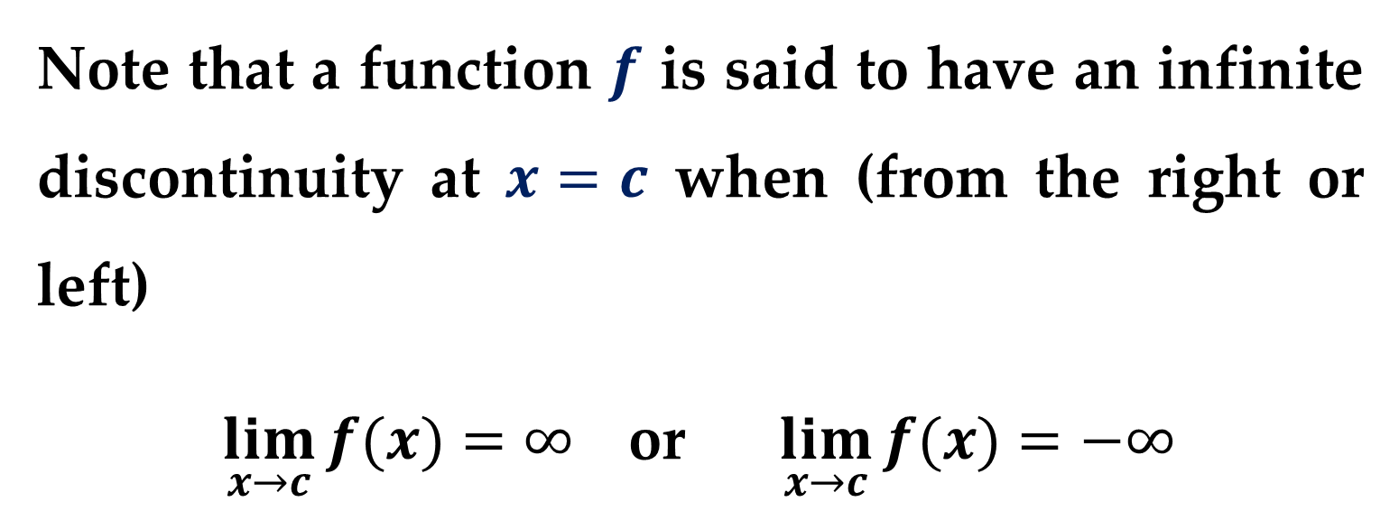

Integrals that possess either property are called $improper integrals$.
Note that a function $f$ is said to have an infinite discontinuity at $x=c$ when (from the right or left)
$\lim_{x→c}{f(x)}=∞$ or $\lim_{x→c}{f(x)}=−∞$

Slide 6
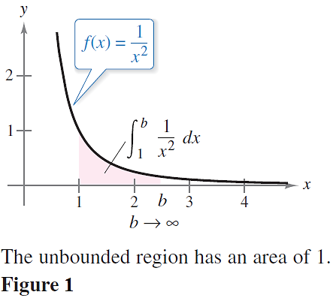
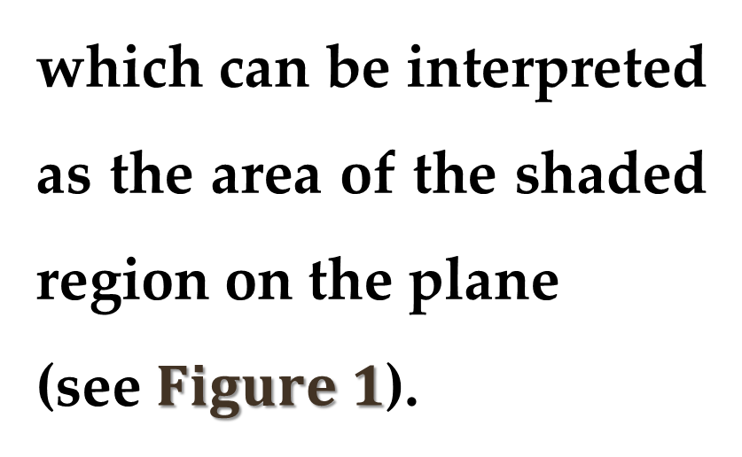
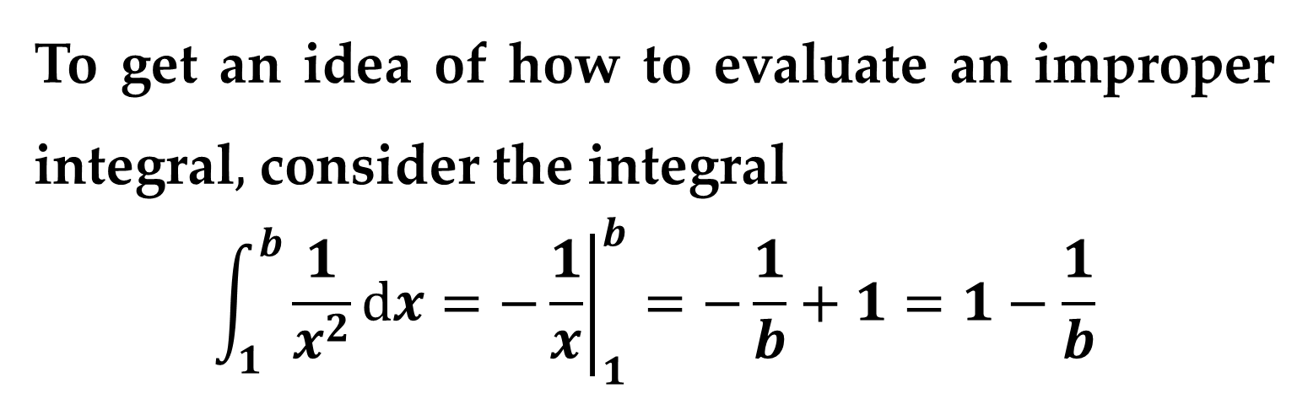
To get an idea of how to evaluate an improper integral$,$ consider the integral
$$\int_{1}^{b}{\frac{1}{x^{2}}}dx={\left.−\frac{1}{x}\right|}_{1}^{b}=−\frac{1}{b}+1=1−\frac{1}{b}$$
which can be interpreted as the area of the shaded region on the plane
(see $Figure 1$).

Slide 7
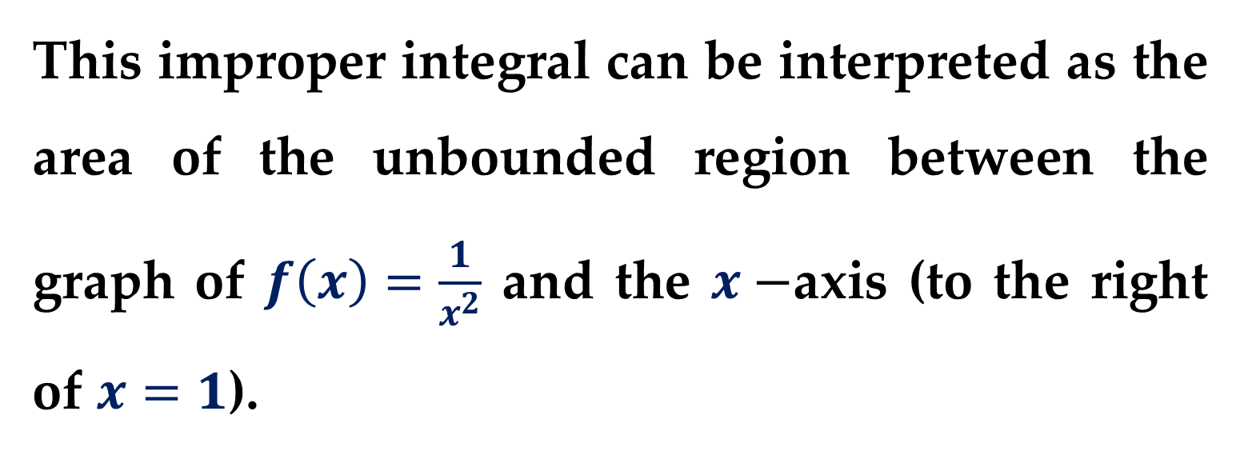
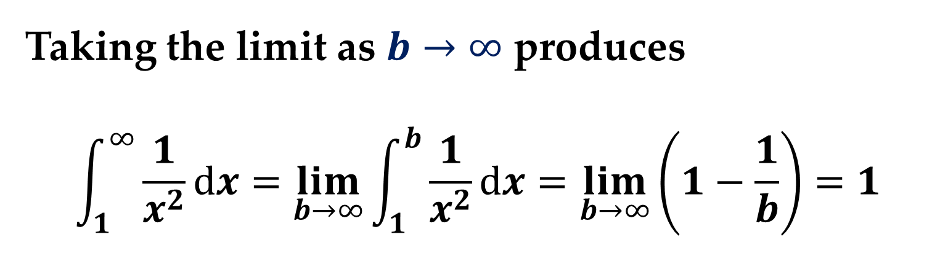
Taking the limit as $b→∞$ produces
$$\int_{1}^{∞}{\frac{1}{x^{2}}}dx=\lim_{b→∞}{\int_{1}^{b}{\frac{1}{x^{2}}}dx}=\lim_{b→∞}\left(1−\frac{1}{b}\right)=1$$
This improper integral can be interpreted as the area of the unbounded region between the graph of $f\left(x\right)=\frac{1}{x^{2}}$ and the $x−$axis (to the right of $x=1$).

Slide 8
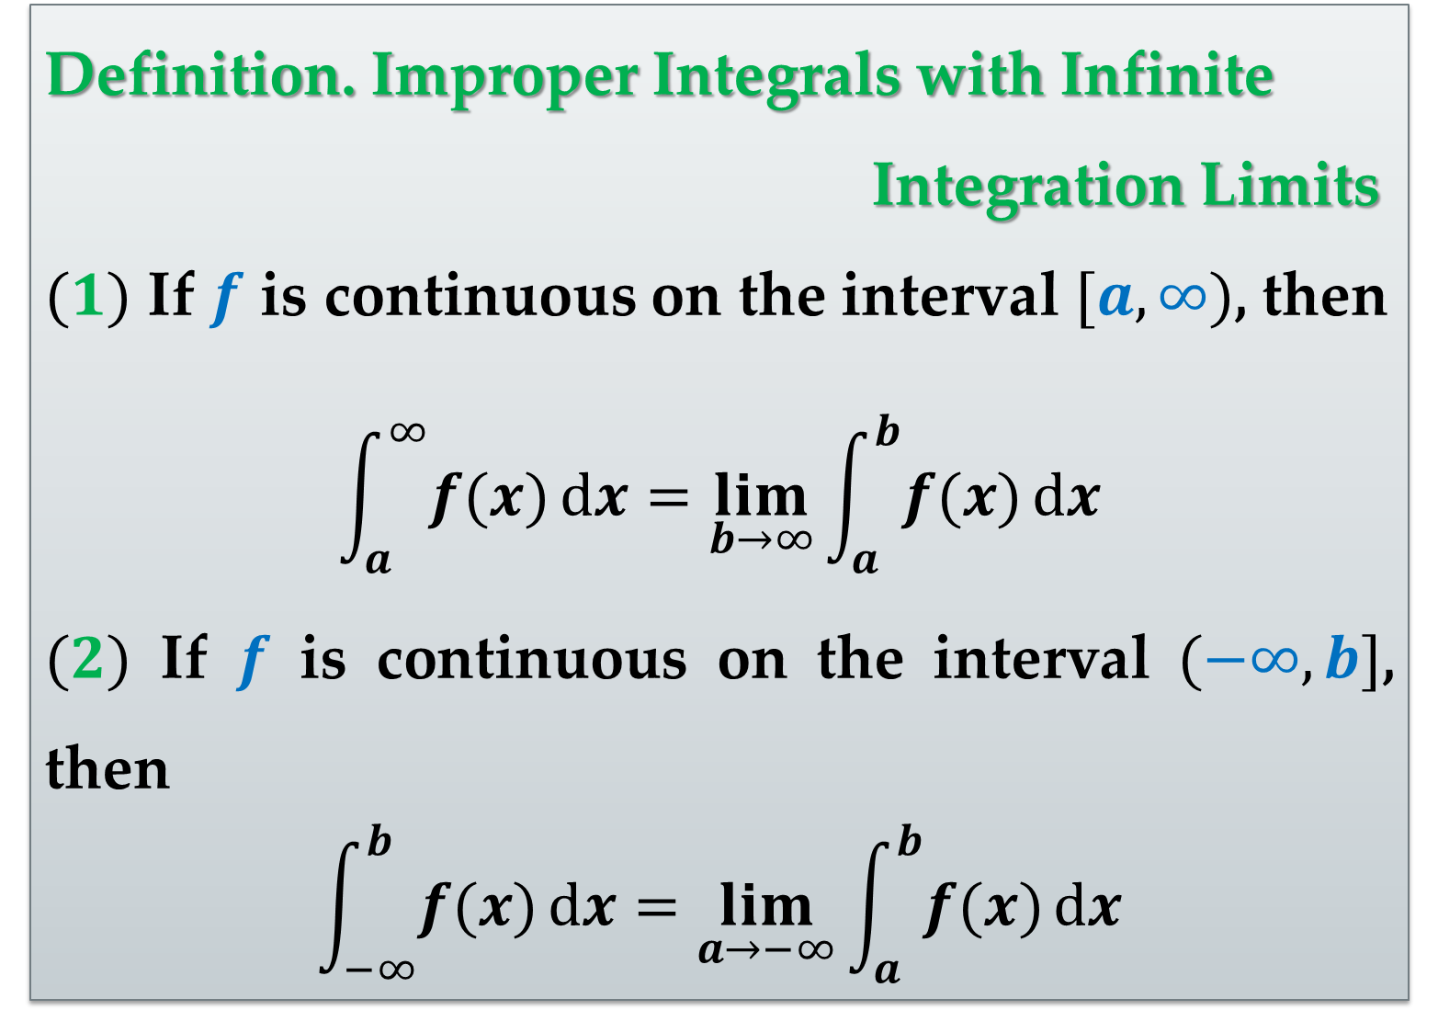
Definition. Improper Integrals with Infinite
Integration Limits
$(1)$ If $f$ is continuous on the interval $[a,∞)$, then
$$\int_{a}^{∞}{f(x)}dx=\lim_{b→∞}{\int_{a}^{b}{f(x)}dx}$$
$(2)$ If $f$ is continuous on the interval $(−∞,b]$, then
$$\int_{−∞}^{b}{f(x)}dx=\lim_{a→−∞}{\int_{a}^{b}{f(x)}dx}$$

Slide 9
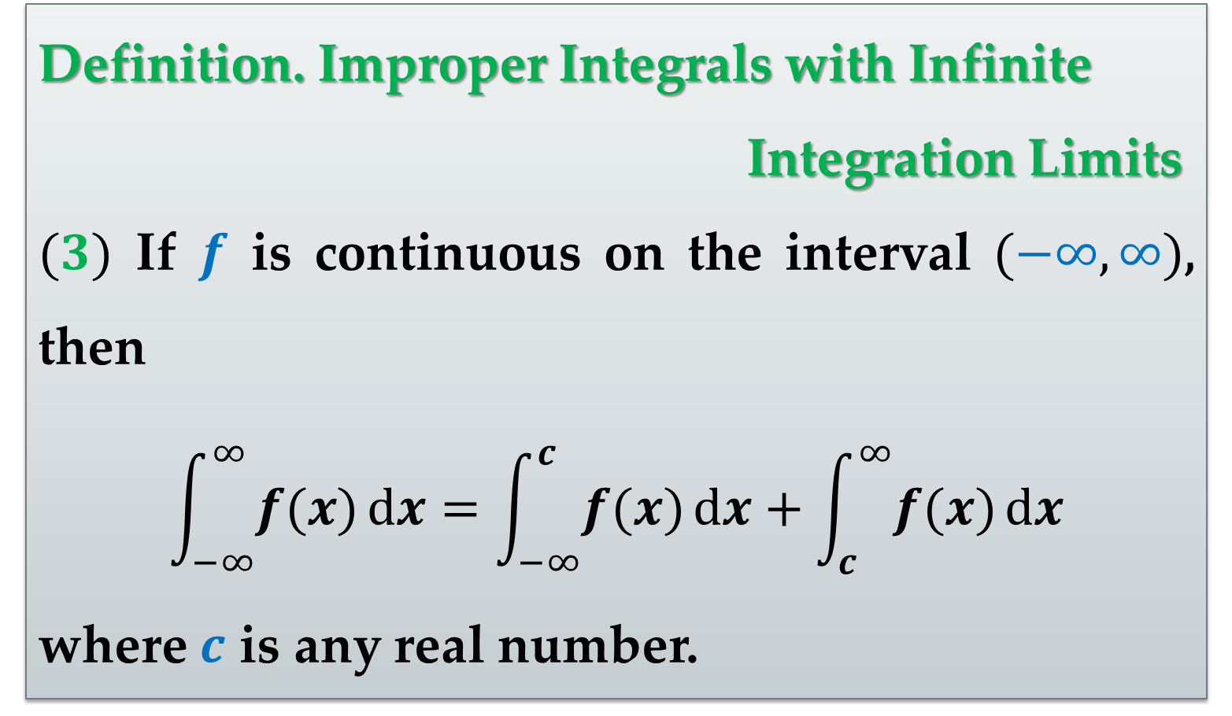
Definition. Improper Integrals with Infinite
Integration Limits
$(3)$ If $f$ is continuous on the interval $(−∞,∞)$, then
$$\int_{−∞}^{∞}{f(x)}dx=\int_{−∞}^{c}{f(x)}dx+\int_{c}^{∞}{f(x)}dx$$
where $c$ is any real number.

Slide 10
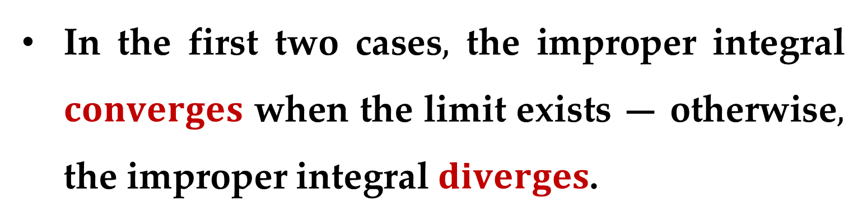
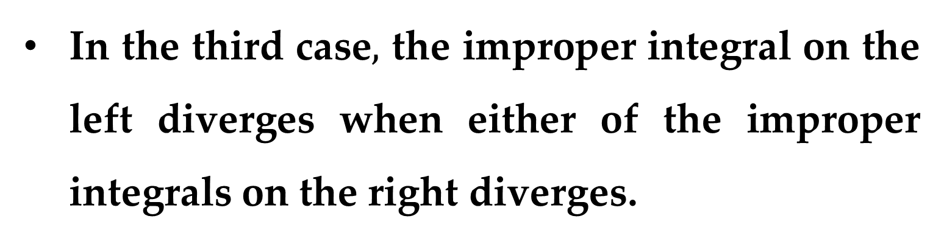
In the first two cases$,$ the improper integral $converges$ when the limit exists — otherwise$,$ the improper integral $diverges$.
In the third case$,$ the improper integral on the left diverges when either of the improper integrals on the right diverges.

Slide 11
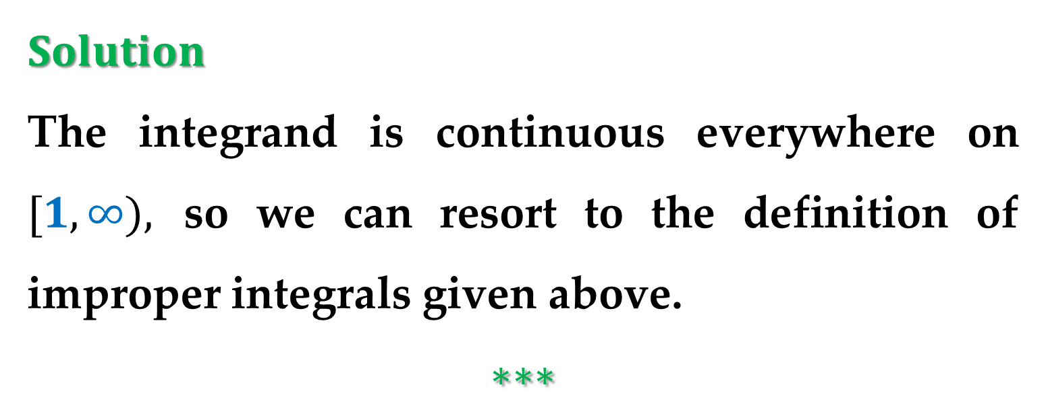
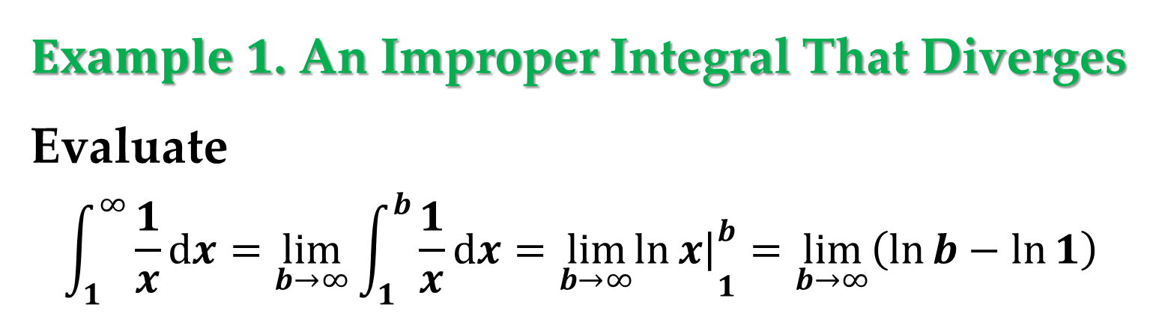
$Example 1$. An Improper Integral That Diverges
Evaluate
$$\int_{1}^{∞}{\frac{1}{x}dx}=\lim_{b→∞}{\int_{1}^{b}{\frac{1}{x}dx}}={\lim_{b→∞}\left.\ln{x}\right|}_{1}^{b}=\lim_{b→∞}\left(\ln{b}−\ln{1}\right)$$
$Solution$
The integrand is continuous everywhere on $[1,∞),$ so we can resort to the definition of improper integrals given above.
$$∗∗∗$$

Slide 12
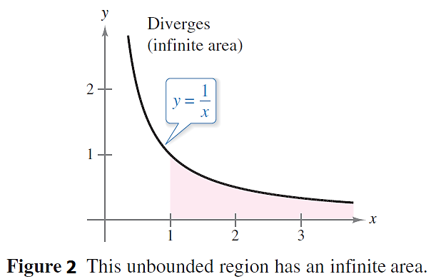
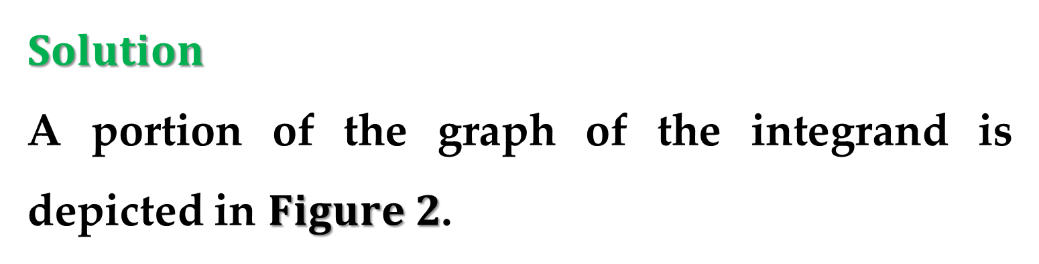
$Solution$
A portion of the graph of the integrand is depicted in $Figure 2$.

Slide 13
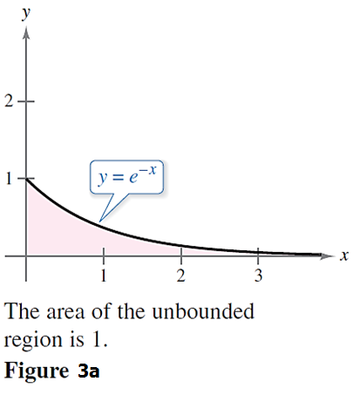
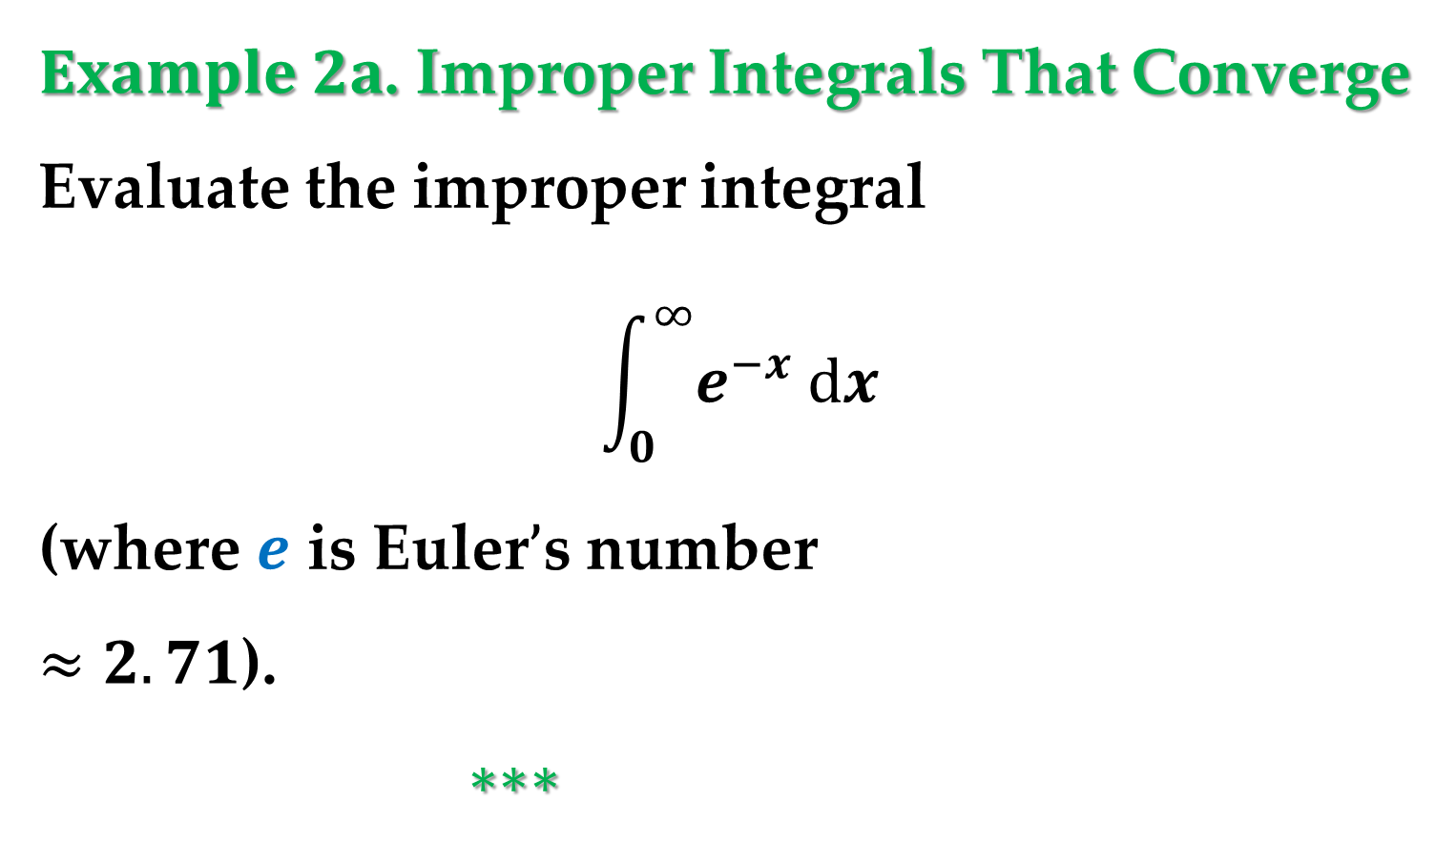
$Example 2a$. Improper Integrals That Converge
Evaluate the improper integral
$$\int_{0}^{∞}{e^{−x} dx}$$
(where $e$ is Euler$’$s number
$≈2.71$).
$∗∗∗$

Slide 14
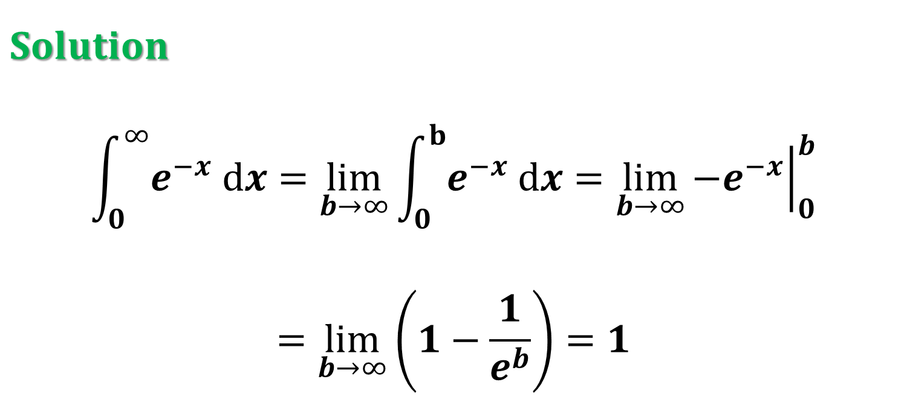
$Solution$
$$\int_{0}^{∞}{e^{−x} dx}=\lim_{b→∞}{\int_{0}^{b}{e^{−x} dx}}=\lim_{b→∞}{{\left.−e^{−x}\right|}_{0}^{b}}$$
$$=\lim_{b→∞}\left(1−\frac{1}{e^{b}}\right)=1$$

Slide 15
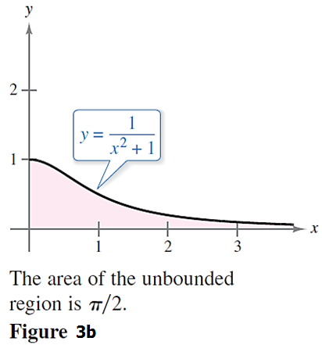
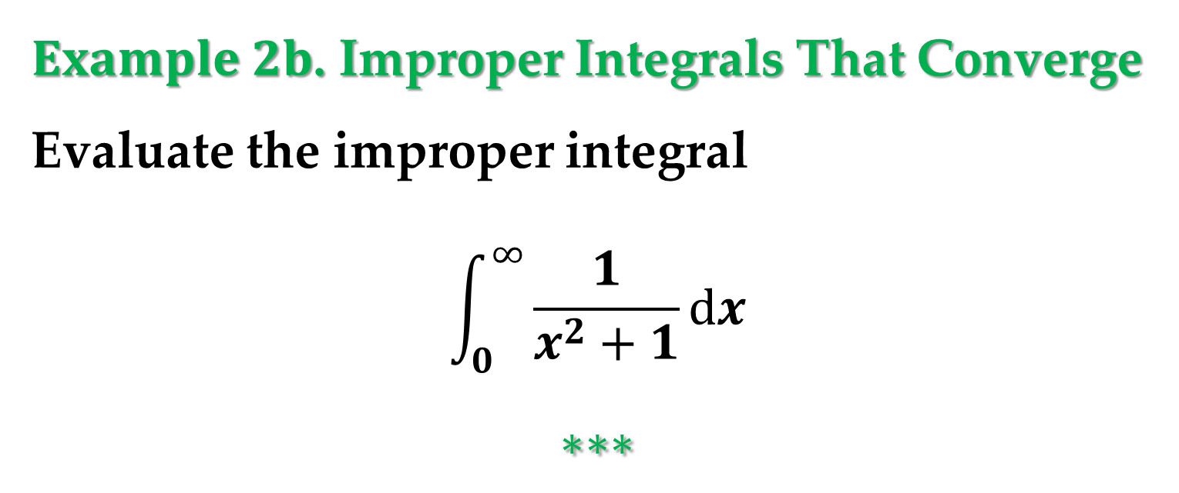
$Example 2b$. Improper Integrals That Converge
Evaluate the improper integral
$$\int_{0}^{∞}{\frac{1}{x^{2}+1}dx}$$
$$∗∗∗$$

Slide 16
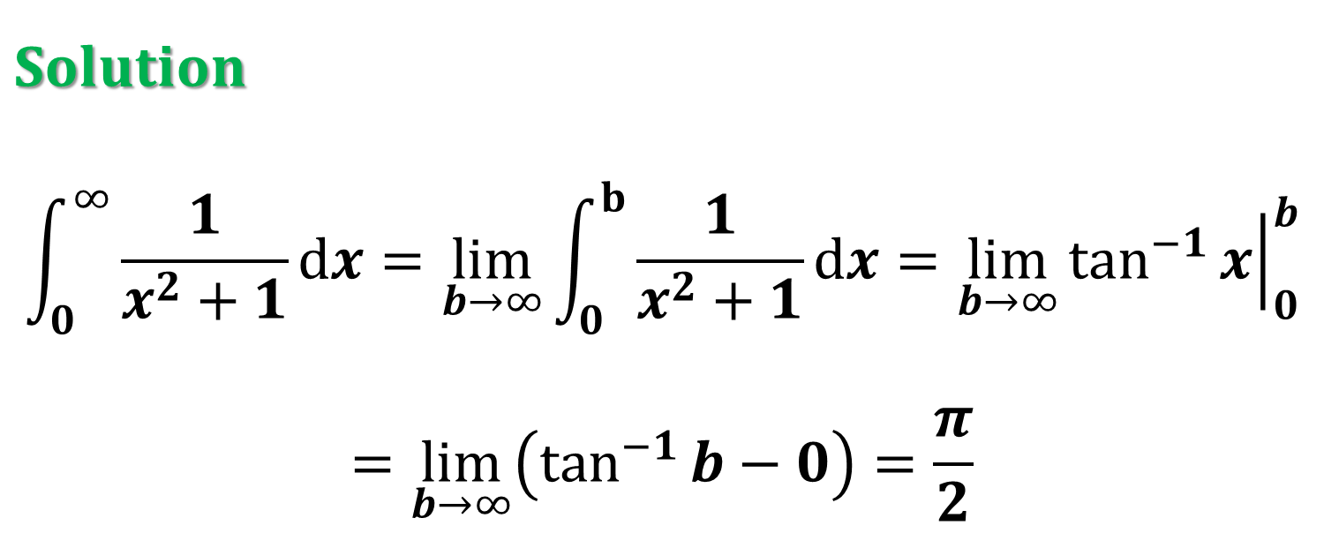
$Solution$
$$\int_{0}^{∞}{\frac{1}{x^{2}+1}dx}=\lim_{b→∞}{\int_{0}^{b}{\frac{1}{x^{2}+1}dx}}=\lim_{b→∞}{{\left.\tan^{−1}{x}\right|}_{0}^{b}}$$
$$=\lim_{b→∞}\left(\tan^{−1}{b}−0\right)=\frac{π}{2}$$

Slide 17


Before evaluating an improper integral$,$ we need to find an antiderivative of the integrand.
For this purpose$,$ in some cases$,$ we can use a well$−$known technique in calculus known as $Integration by Parts$.
This technique can be applied to a wide variety of functions and is particularly useful for integrands involving products of algebraic and transcendental functions.

Slide 18
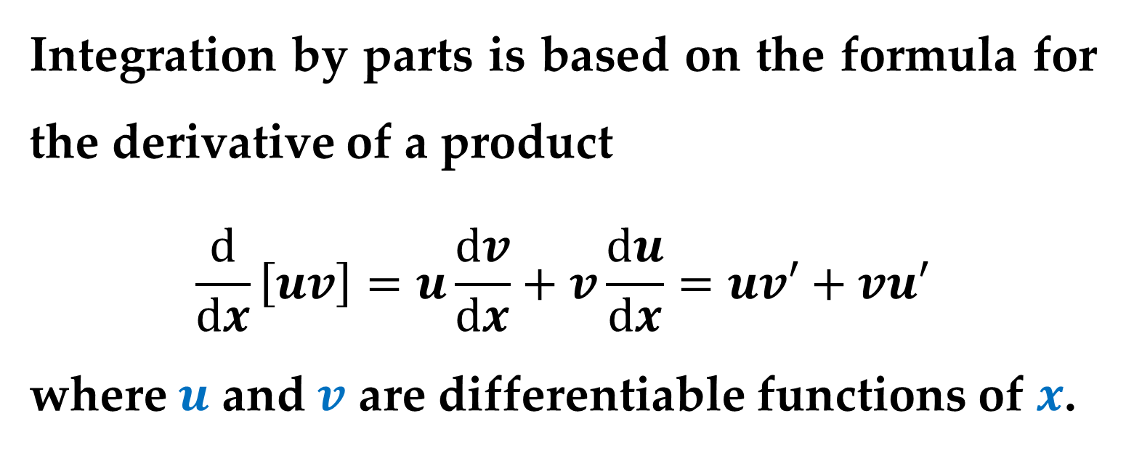
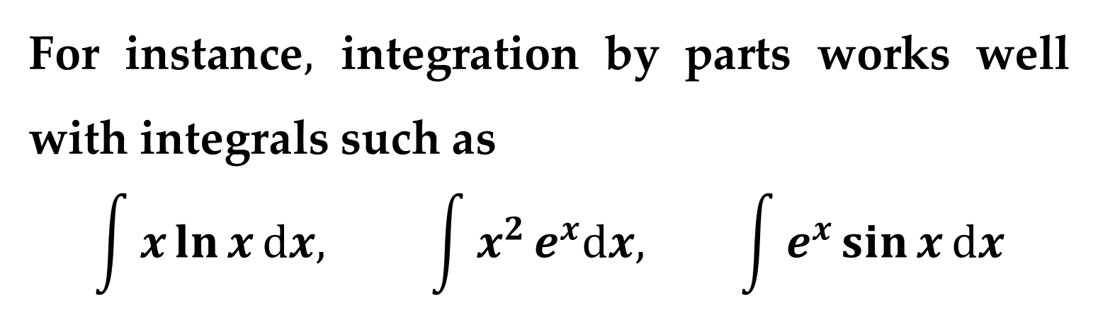
For instance$,$ integration by parts works well with integrals such as
$$\int{x}\ln{x}dx, \int{x^{2}}e^{x}dx, \int{e^{x}}\sin{x}dx$$
Integration by parts is based on the formula for the derivative of a product
$$\frac{d}{dx}\left[uv\right]=u\frac{dv}{dx}+v\frac{du}{dx}=uv′+vu′$$
where $u$ and $v$ are differentiable functions of $x$.

Slide 19
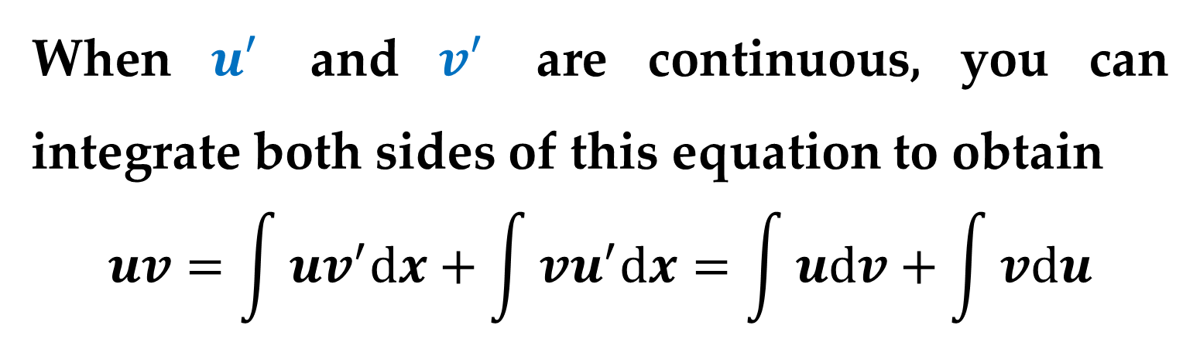
When $u′$ and $v′$ are continuous, you can integrate both sides of this equation to obtain
$$uv=\int{uv^{′}dx}+\int{vu^{′}dx}=\int{udv}+\int{vdu}$$

Slide 20
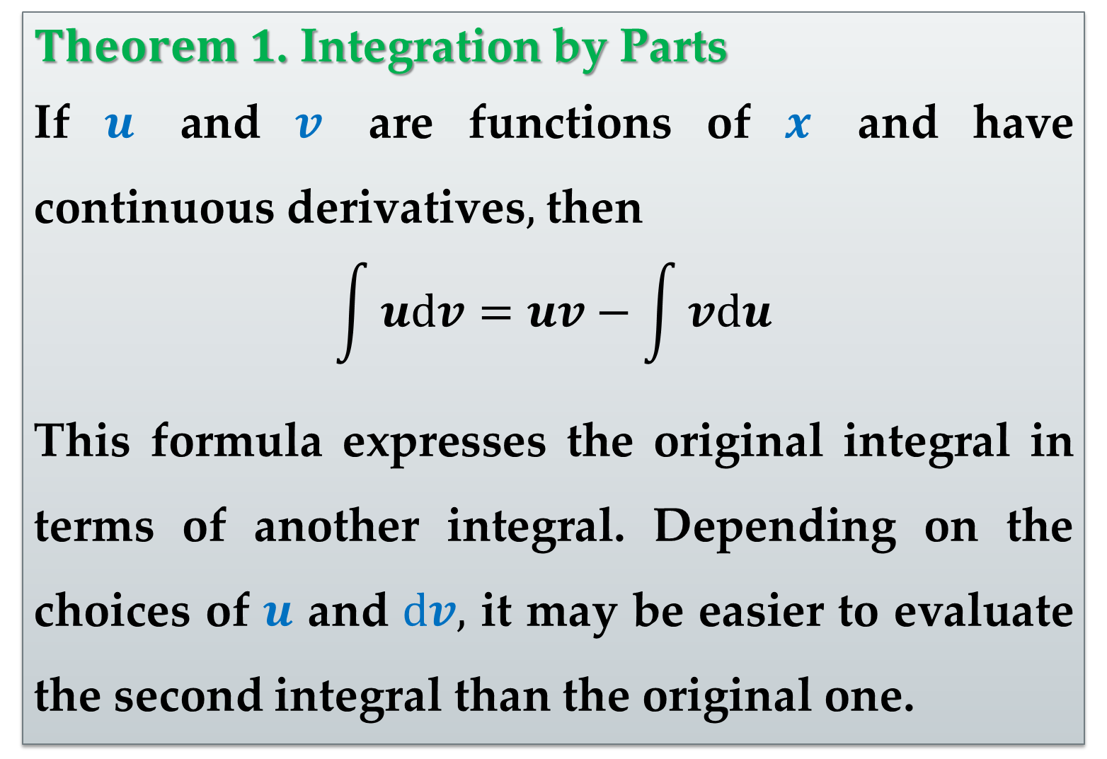
$Theorem 1$. Integration by Parts
If $u$ and $v$ are functions of $x$ and have continuous derivatives$,$ then
$$\int{udv}=uv−\int{vdu}$$
This formula expresses the original integral in terms of another integral. Depending on the choices of $u$ and $dv,$ it may be easier to evaluate the second integral than the original one.

Slide 21
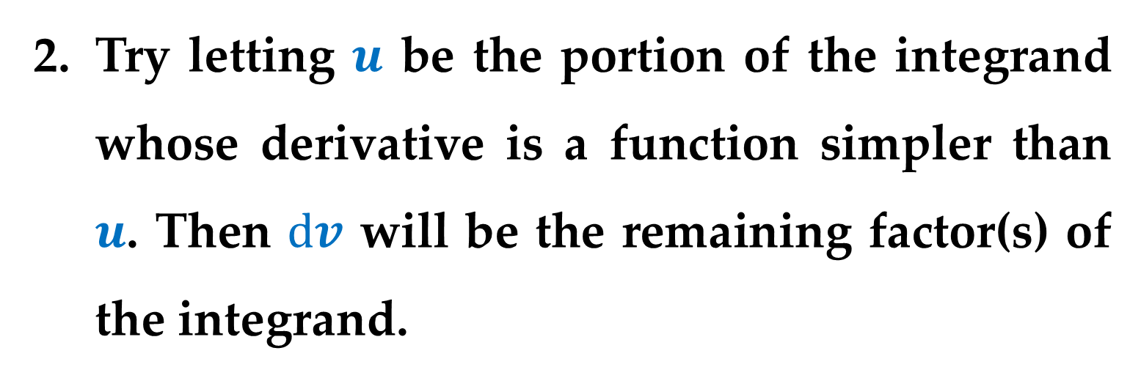
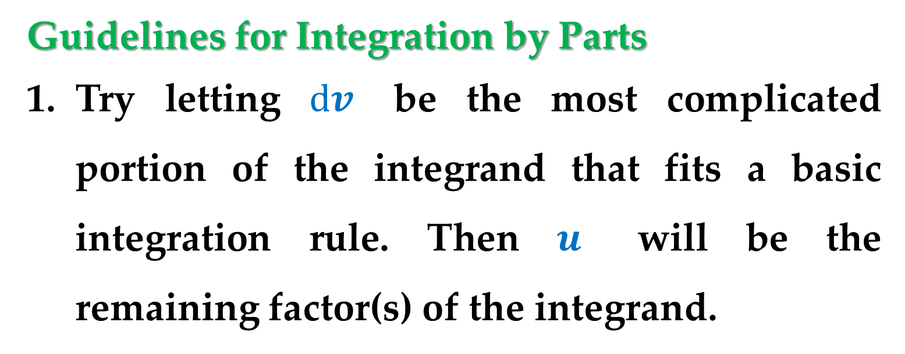
Guidelines for Integration by Parts
Try letting $dv$ be the most complicated portion of the integrand that fits a basic integration rule. Then $u$ will be the remaining factor(s) of the integrand.
Try letting $u$ be the portion of the integrand whose derivative is a function simpler than $u$. Then $dv$ will be the remaining factor(s) of the integrand.

Slide 22
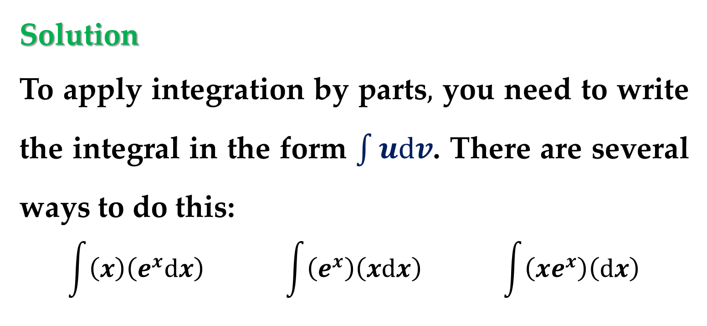

$Example 3$. Integration by Parts
Find
$$\int{x}e^{x}dx$$
Solution
To apply integration by parts$,$ you need to write the integral in the form $\int{udv}$. There are several ways to do this:
$$\int{\left(x\right)\left(e^{x}dx\right)} \int{\left(e^{x}\right)\left(xdx\right)} \int{\left(xe^{x}\right)\left(dx\right)}$$

Slide 23
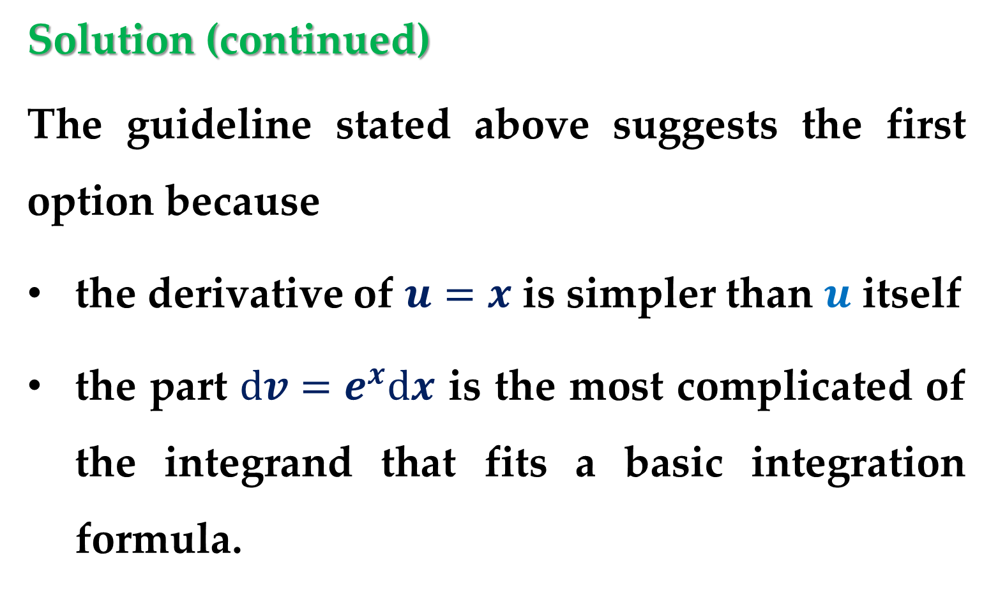
Solution (continued)
The guideline stated above suggests the first option because
the derivative of $u=x$ is simpler than $u$ itself
the part $dv=e^{x}dx$ is the most complicated of the integrand that fits a basic integration formula.

Slide 24
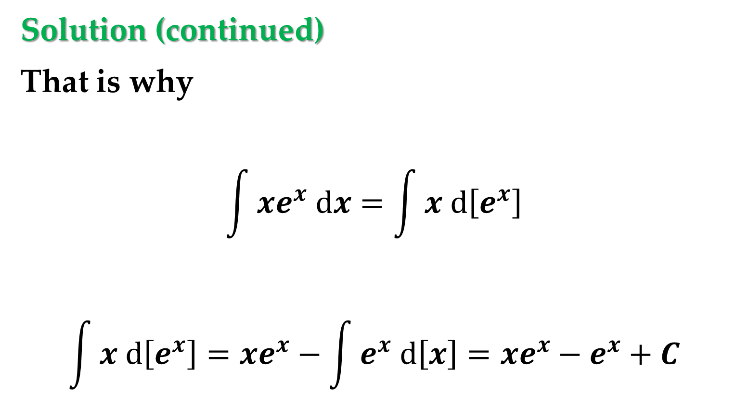
Solution (continued)
That is why
$$\int{xe^{x} dx}=\int{x d\left[e^{x}\right]}$$
$$\int{x d\left[e^{x}\right]}=xe^{x}−\int{e^{x} d\left[x\right]}=xe^{x}−e^{x}+C$$

Slide 25
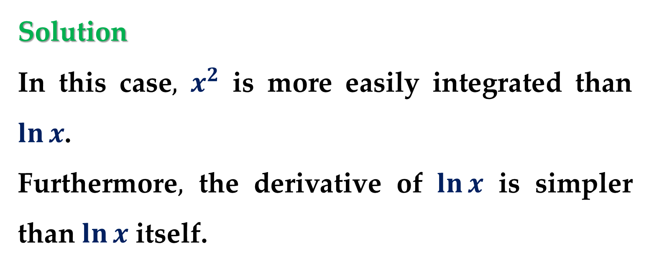

Example 4. Integration by Parts
Find
$$\int{x^{2}}\ln{x}dx$$
Solution
In this case$,$ $x^{2}$ is more easily integrated than $\ln{x}$.
Furthermore$,$ the derivative of $\ln{x}$ is simpler than $\ln{x}$ itself.

Slide 26

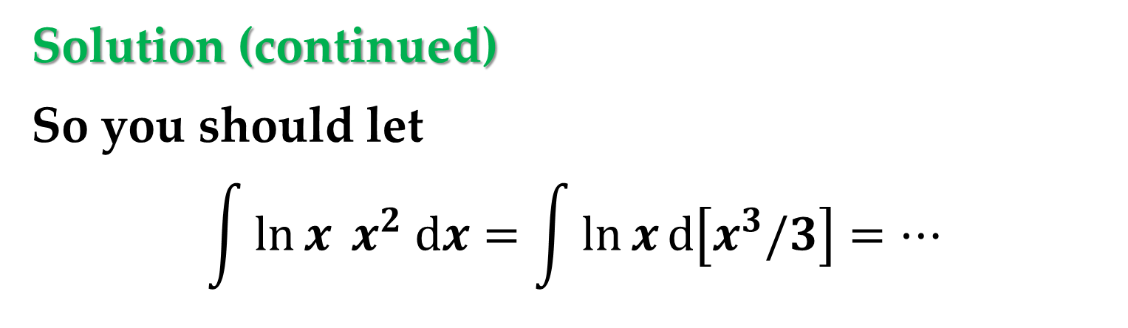
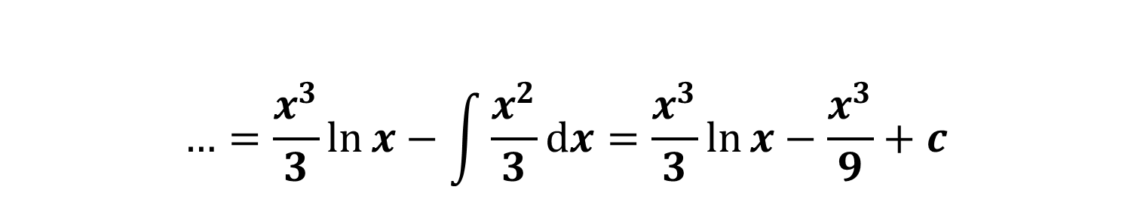
Solution (continued)
So you should let
$$\int{\ln{x} x^{2} dx}=\int{\ln{x}d\left[x^{3}/3\right]}=…$$
$$…=\frac{x^{3}}{3}\ln{x}−\int{\frac{x^{3}}{3}d\left[\ln{x}\right]}=…$$
$$…=\frac{x^{3}}{3}\ln{x}−\int{\frac{x^{2}}{3}dx}=\frac{x^{3}}{3}\ln{x}−\frac{x^{3}}{9}+c$$

Slide 27
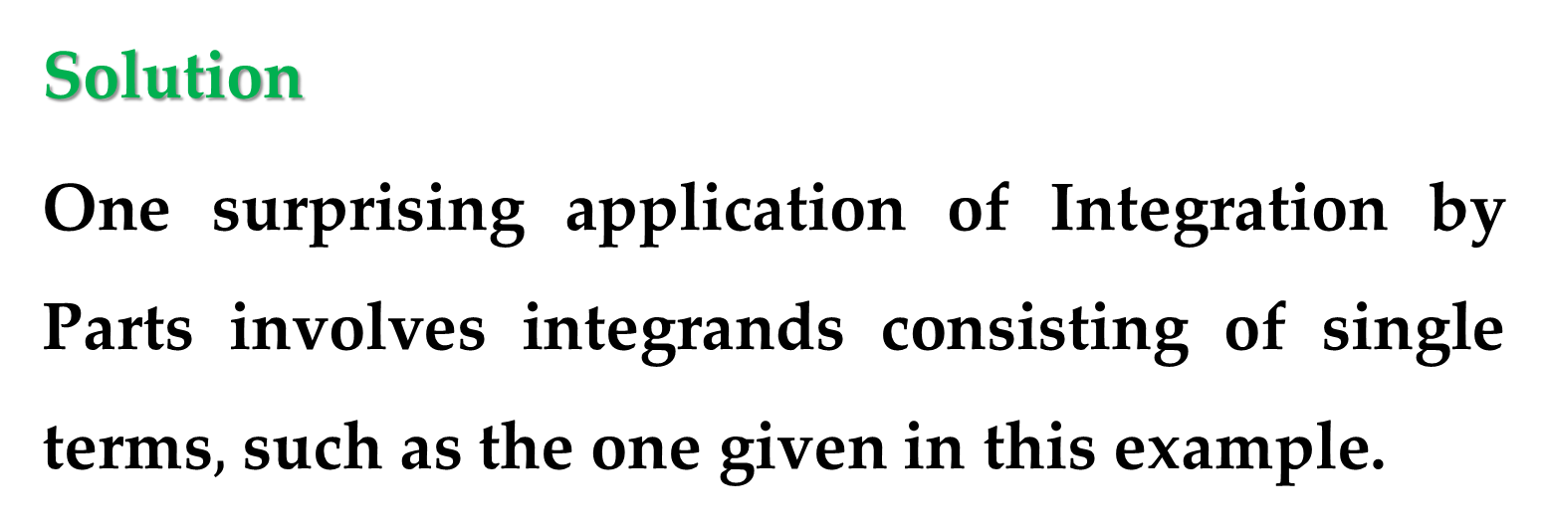

Example 5. An Integrand with a Single Term
Find
$$\int_{0}^{1}{\arcsin{x}}dx$$
Solution
One surprising application of Integration by Parts involves integrands consisting of single terms$,$ such as the one given in this example.

Slide 28
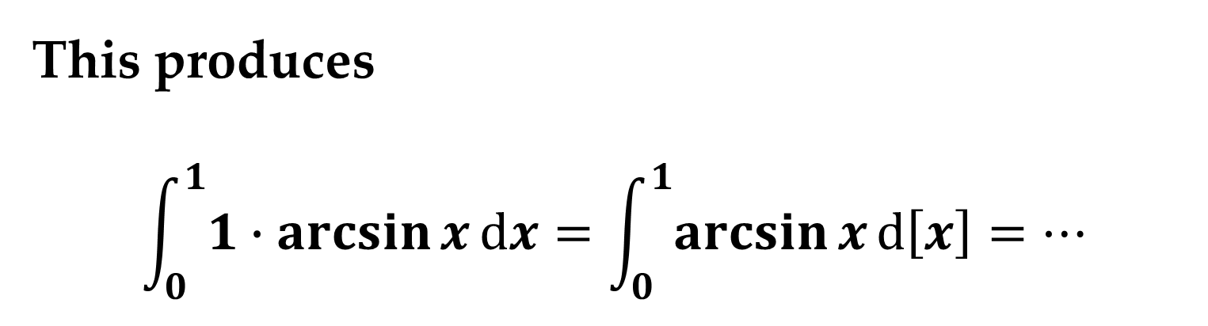
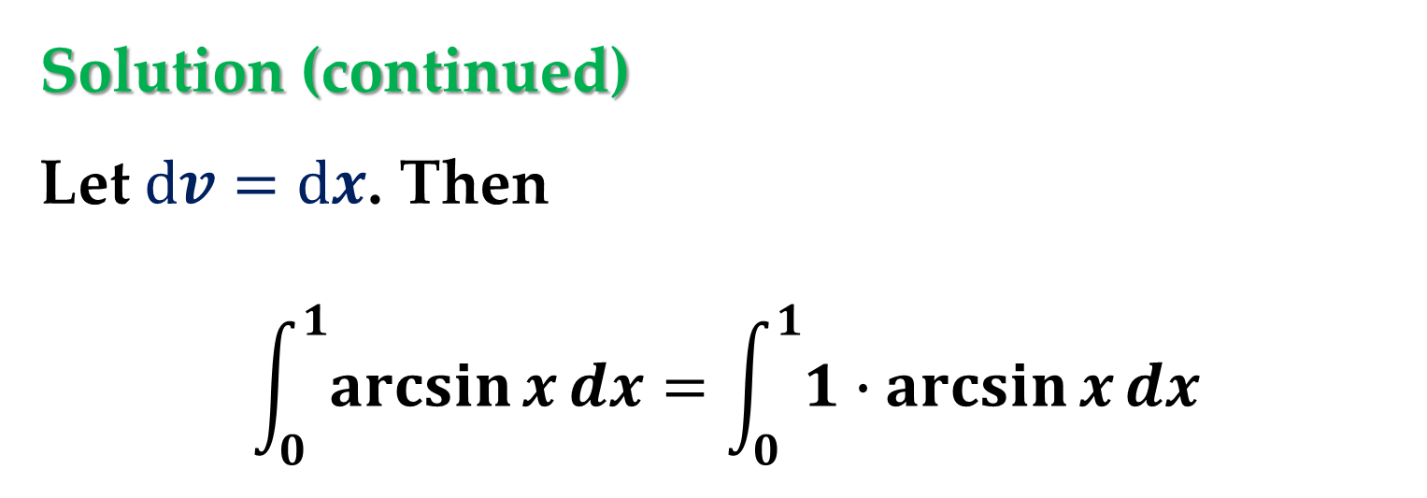
Solution (continued)
Let $dv=dx$. Then
$$\int_{0}^{1}{\arcsin{x}}dx=\int_{0}^{1}{1∙\arcsin{x}}dx$$
This produces
$$\int_{0}^{1}{1∙\arcsin{x}}dx=\int_{0}^{1}{\arcsin{x}}d\left[x\right]=…$$

Slide 29
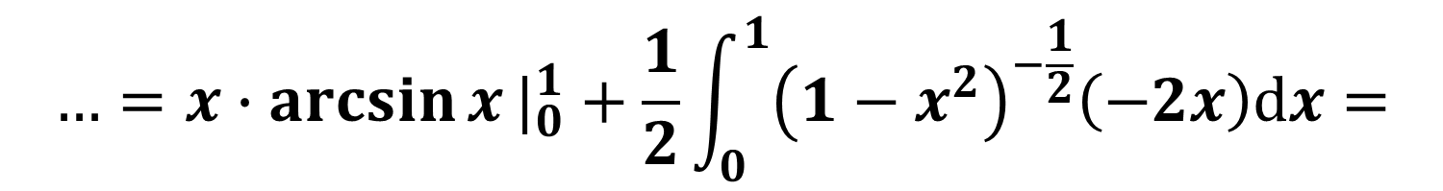

Solution (continued)
$$…=x∙\arcsin{x}|_{0}^{1}−\int_{0}^{1}{\frac{x}{\sqrt{1−x^{2}}}dx}=…$$
$$…=x∙\arcsin{x}|_{0}^{1}+\frac{1}{2}\int_{0}^{1}{{\left(1−x^{2}\right)}^{−\frac{1}{2}}\left(−2x\right)dx}=$$
$$…=x∙\arcsin{x}|_{0}^{1}+\sqrt{1−x^{2}}|_{0}^{1}$$

Slide 30
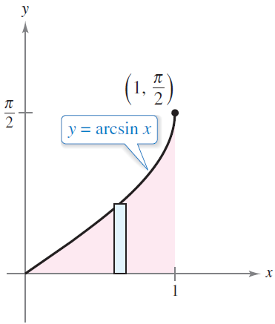
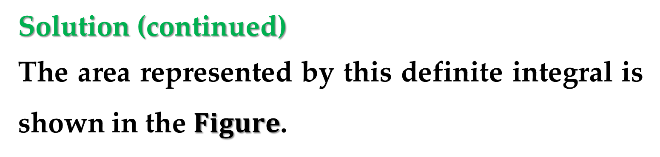
Solution (continued)
The area represented by this definite integral is shown in the $Figure$.

Slide 31
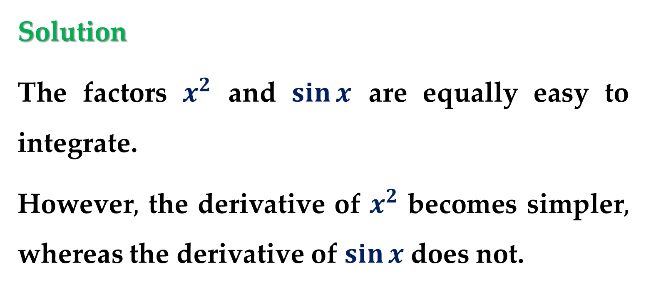

Example 6. Repeated Use of Integration by Parts
Find
$$\int{x^{2}\sin{x}}dx$$
Solution
The factors $x^{2}$ and $\sin{x}$ are equally easy to integrate.
However$,$ the derivative of $x^{2}$ becomes simpler$,$ whereas the derivative of $\sin{x}$does not.

Slide 32
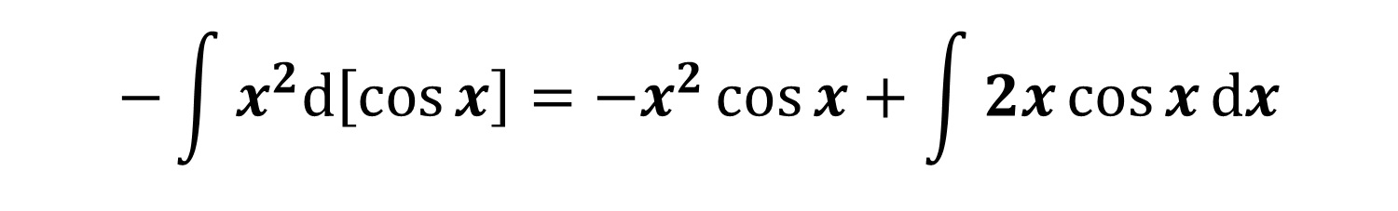
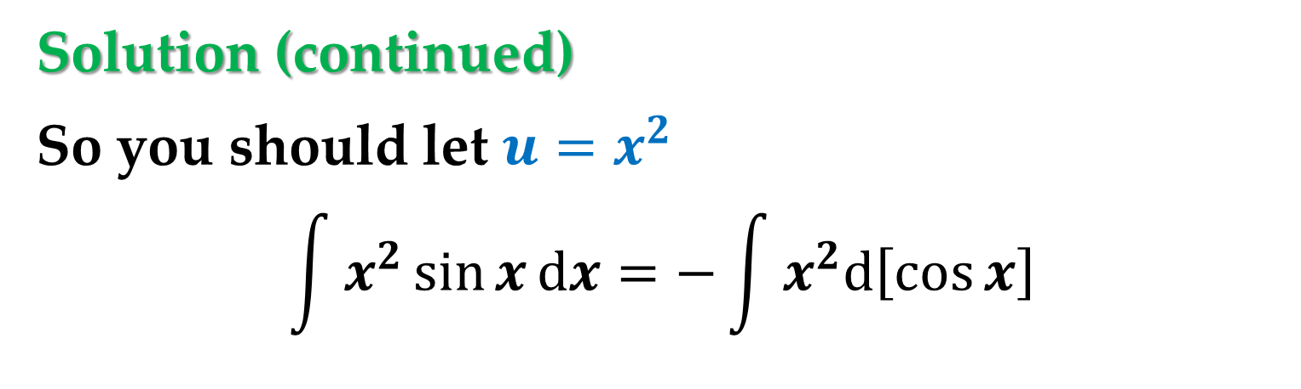
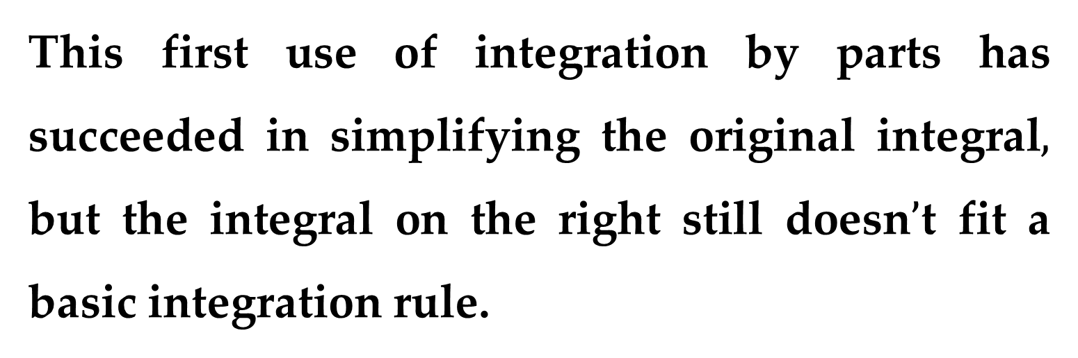
Solution (continued)
So you should let ${u=x}^{2}$
$$\int{x^{2}\sin{x}}dx=−\int{x^{2}d\left[\cos{x}\right]}$$
$$−\int{x^{2}d\left[\cos{x}\right]}=−x^{2}\cos{x}+\int{2x\cos{x}dx}$$
This first use of integration by parts has succeeded in simplifying the original integral$,$ but the integral on the right still doesn$’$t fit a basic integration rule.

Slide 33
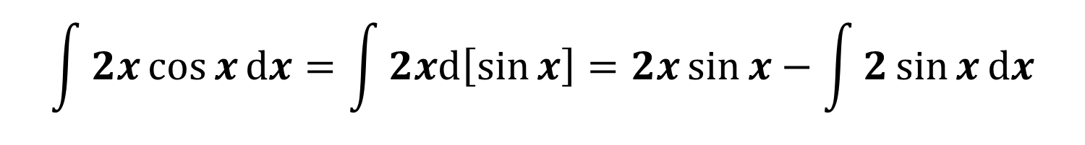
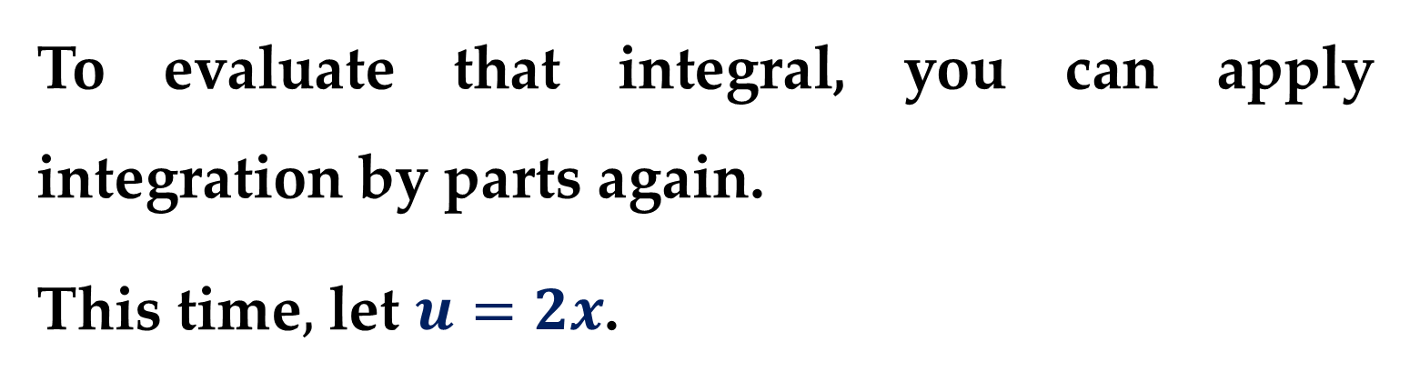
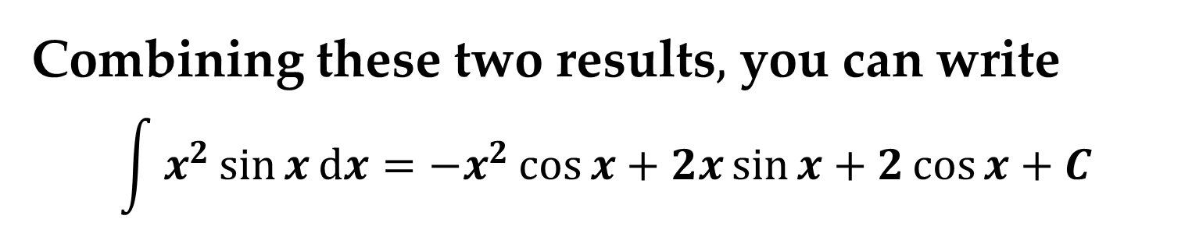
Solution (continued)
To evaluate that integral, you can apply integration by parts again.
This time$,$ let $u=2x$.
$$\int{2x\cos{x}dx}=\int{2xd\left[\sin{x}\right]}=2x\sin{x}−\int{2\sin{x}dx}$$
Combining these two results$,$ you can write
$$\int{x^{2}\sin{x}}dx=−x^{2}\cos{x}+2x\sin{x}+2\cos{x}+C$$

Slide 34
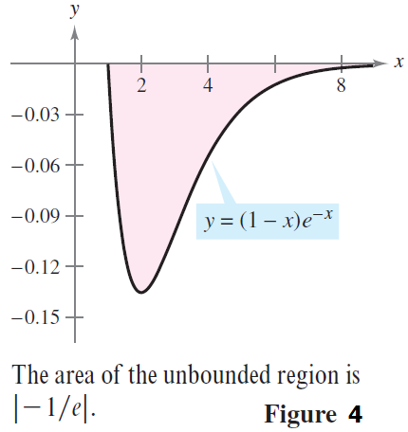
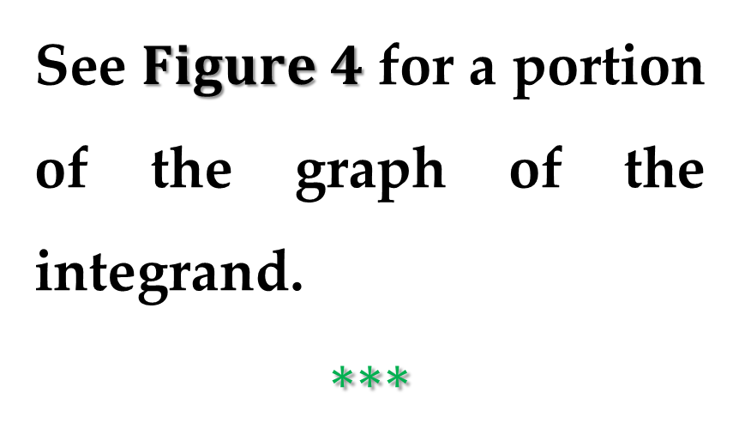

Example 7. Evaluating Improper Integral
Evaluate
$$\int_{1}^{∞}{(1−x)e^{−x}dx}$$
See $Figure 4$ for a portion of the graph of the integrand.
$$∗∗∗$$

Slide 35

Solution (continued)
$$\int_{1}^{∞}{(1−x)e^{−x}dx}=\lim_{b→∞}{\int_{1}^{b}{(1−x)e^{−x}dx}}$$
$$\int_{1}^{b}{(1−x)e^{−x}dx}=\int_{1}^{b}{e^{−x}dx}−\int_{1}^{b}{xe^{−x}dx}$$
$$\int_{1}^{b}{e^{−x}dx}={\left.−e^{−x}\right|}_{1}^{b}=e^{−1}−e^{−b}$$

Slide 36

Solution (continued)
$$−\int_{1}^{b}{xd\left[e^{−x}\right]}={\left.−xe^{−x}\right|}_{1}^{b}+\int_{1}^{b}{e^{−x}dx}=$$
$$=e^{−1}−be^{−b}−{\left.e^{−x}\right|}_{1}^{b}=$$
$$=e^{−1}−be^{−b}+e^{−1}−e^{−b}$$
$$\int_{1}^{∞}{(1−x)e^{−x}dx}=\lim_{b→∞}\left[be^{−b}−e^{−1}\right]=$$
$$=−1/e$$

Slide 37


Example 8. Infinite Upper and Lower Limits of Integration
Evaluate
$$\int_{−∞}^{∞}{\frac{e^{x}}{1+e^{2x}}dx}$$
Solution
Note that the integrand is continuous on $(−∞,∞)$.
To evaluate the integral$,$ you can break it into two parts$,$ choosing $c=0$ as a convenient value.

Slide 38


Solution (continued)
A portion of the graph of the integrand is depicted in $Figure 5$.

Slide 39

Solution (continued)
$$\int_{−∞}^{∞}{\frac{e^{x}}{1+e^{2x}}dx}=\int_{−∞}^{0}{\frac{e^{x}}{1+e^{2x}}dx}+\int_{0}^{∞}{\frac{e^{x}}{1+e^{2x}}dx}$$
$$=\lim_{a→−∞}{\int_{a}^{0}{\frac{e^{x}}{1+e^{2x}}dx}}+\lim_{b→∞}{\int_{0}^{b}{\frac{e^{x}}{1+e^{2x}}dx}}$$

Slide 40

Solution (continued)
$$\int{\frac{e^{x}}{1+{\left(e^{x}\right)}^{2}}dx}=\left[u=e^{x}; du=e^{x}dx\right]=$$
$$\int{\frac{du}{1+u^{2}}}=\tan^{−1}{u}=\tan^{−1}{e^{x}}$$

Slide 41

Solution (continued)
$$\tan^{−1}{e^{x}}$$
$${\lim_{a→−∞}\left.\tan^{−1}{e^{x}}\right|}_{a}^{0}+{\lim_{b→∞}\left.\tan^{−1}{e^{x}}\right|}_{0}^{b}=$$
$$=\lim_{a→−∞}\left(\tan^{−1}{e^{0}}−\tan^{−1}{e^{a}}\right)+$$
$$+\lim_{b→∞}\left(\tan^{−1}{e^{b}}−\tan^{−1}{e^{0}}\right)=$$
$$=\frac{π}{2}−0=\frac{π}{2}$$

Slide 42


The second basic type of improper integral is one that has an $infinite discontinuity$ at or between the limits of integration.
Definition. Improper Integrals with Infinite
Discontinuities
$(1)$ If $f$ is continuous on the interval $[a,b)$ and has an infinite discontinuity at $b,$ then
$$\int_{a}^{b}{f\left(x\right)dx}=\lim_{c→b^{−}}{\int_{a}^{c}{f\left(x\right)dx}}$$

Slide 43


Definition. Improper Integrals with Infinite
Discontinuities
$(2)$ If $f$ is continuous on the interval $(a,b]$ and has an infinite discontinuity at $a,$ then
$$\int_{a}^{b}{f\left(x\right)dx}=\lim_{c→a^{+}}{\int_{c}^{b}{f\left(x\right)dx}}$$
In the first two cases$,$ the improper integral converges when the limit exists — otherwise$,$ the improper integral diverges.

Slide 44


Definition. Improper Integrals with Infinite
Discontinuities
$(3)$ If $f$ is continuous on the interval $[a,b],$ except for some $c$ in $(a,b)$ at which $f$ has an infinite discontinuity$,$ then
$$\int_{a}^{b}{f\left(x\right)dx}=\int_{a}^{c}{f\left(x\right)dx}+\int_{c}^{b}{f\left(x\right)dx}$$
In this case$,$ the improper integral on the left diverges when either of the improper integrals on the right diverges.

Slide 45



Example 9. An Improper Integral with an
Infinite Discontinuity
Evaluate
$$\int_{0}^{1}{\frac{1}{\sqrt[3]{x}}dx}$$
Solution
The integrand has an infinite discontinuity at $x=0,$ as shown in $Figure$.

Slide 46


Solution (continued)
You can evaluate this integral as shown below
$$\int_{0}^{1}{\frac{1}{\sqrt[3]{x}}dx}=\lim_{a→0^{+}}{\int_{a}^{1}{\frac{1}{\sqrt[3]{x}}dx}}=…$$
$$…=\lim_{a→0^{+}}{{\left[\frac{3}{2}\sqrt[3]{x^{2}}\right]}_{a}^{1}}=\lim_{a→0^{+}}{\frac{3}{2}\left(1−\sqrt[3]{b^{2}}\right)}=\frac{3}{2}$$

Slide 47

$Example 10$. An Improper Integral That
Diverges
Evaluate
$$\int_{0}^{2}{\frac{1}{x^{3}}dx}$$
$$∗∗∗$$

Slide 48

$Example 11$. An Improper Integral with an
Interior Discontinuity
Evaluate
$$\int_{−1}^{2}{\frac{1}{x^{3}}dx}$$
$$∗∗∗$$

Slide 49


Example 12. A Doubly Improper Integral
Evaluate
$$\int_{0}^{∞}{\frac{1}{\sqrt{x}(x+1)}dx}$$
Solution
To evaluate this integral$,$ split it at a convenient point (say$,$ $x=1$) and write:
$$\int_{0}^{∞}{\frac{1}{\sqrt{x}(x+1)}dx}=\int_{0}^{1}{\frac{1}{\sqrt{x}(x+1)}dx}+\int_{1}^{∞}{\frac{1}{\sqrt{x}(x+1)}dx}$$

Slide 50



Solution (continued)
$$\lim_{a→0^{+}}{{\left[2 arctan \sqrt{x}\right]}_{a}^{1}}+\lim_{b→∞}{{\left[2 arctan \sqrt{x}\right]}_{1}^{b}}=π$$
A portion of the graph of the integrand is depicted in $Figure 7$.

Slide 51
Thank you for attention

